Slide 1

Using cryptography with the Blockchain
Armand HURAULT

Slide 2
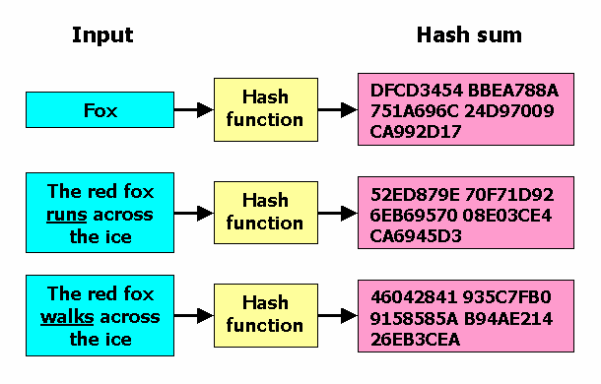
What is a hash ?
“Function that transforms a given set of data into a string of fixed size”
-Only works in one direction
-Deterministic
-Changing a single bit changes the hash sum
-Also used to cipher passwords -Example of hash function : MD5, SHA-256 …
-Keccak-256 (used by Ethereum)

Slide 3

Summary
Characteristics of a Blockchain
Example of implementation : Key exchange + Message encryption

Slide 4
I)Characteristics of a Blockchain

Slide 5
Definition :
“A blockchain is a decentralized, distributed and public digital ledger (=~database) that is used to record transactions across many computers so that the record cannot be altered retroactively without the alteration of all subsequent blocks and the consensus of the network.”
Decentralized
Distributed
Immutable
Public
Unforgeability

Slide 6
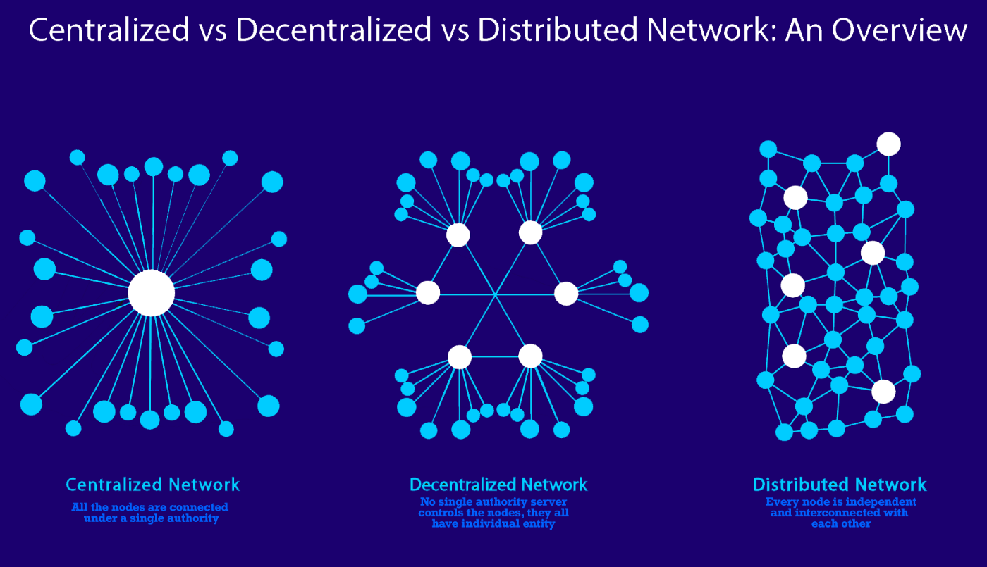
Decentralized / Distributed

Slide 7
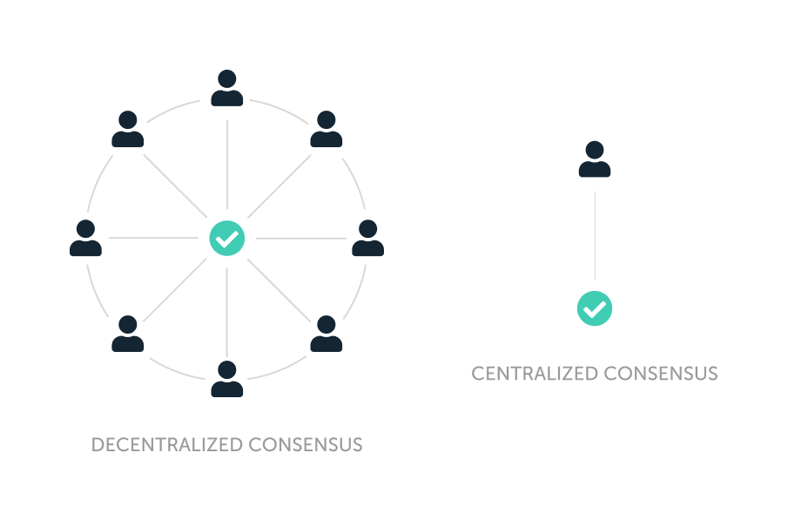
Decentralized / Distributed

Slide 8
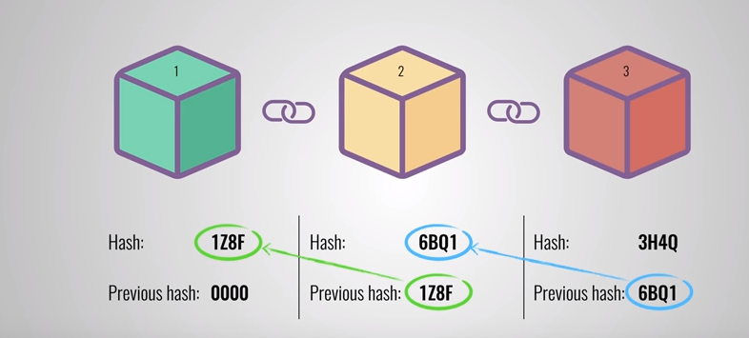
Immutable (Impossible to alter)

Slide 9

Public

Slide 10
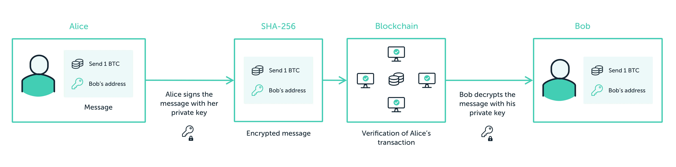
Unforgeability (Impossible to falsify) : Private/Public Key for Digital Signature
Format of an Ethereum public address : 0xd6c5C0E7e2D398FE6f8A0345842ff604FA84B698

Slide 11
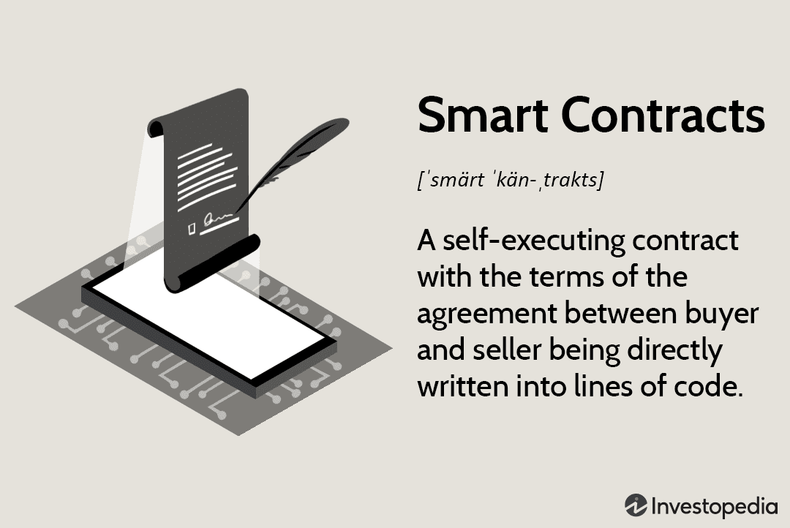
What is a Smart Contract

Slide 12
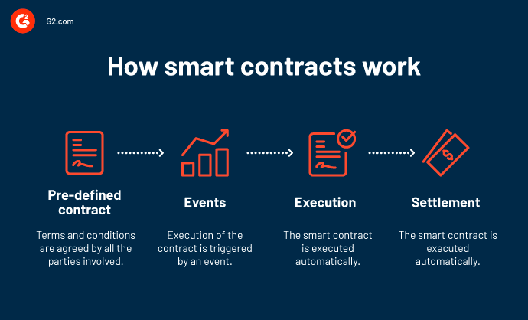

Slide 13
Other type of implementation for Blockchain and Smart Contract
Cryptocurrencies (Bitcoin, Ethereum etc…) and NFT
Insurance
Real estate
Supply Chain
Hospital
Voting

Slide 14
II)Example of cryptographic implementation in a Smart Contract : Key exchange + Message encryption/decryption

Slide 15
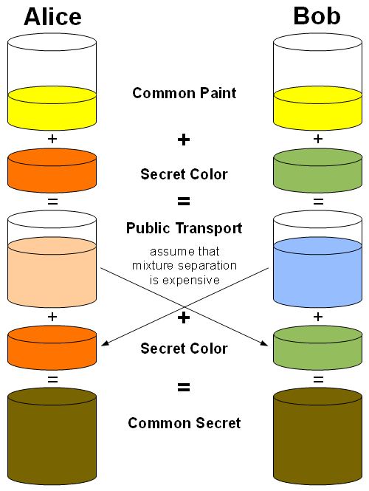
Diffie Helman Key Exchange for symmetric encryption

Slide 16
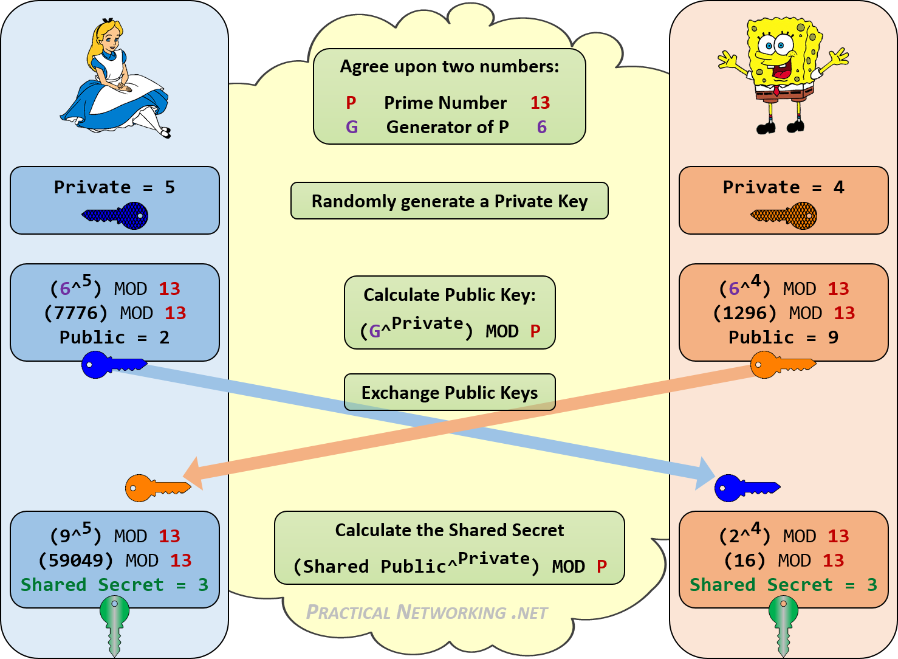
Diffie Helman Key Exchange

Slide 17
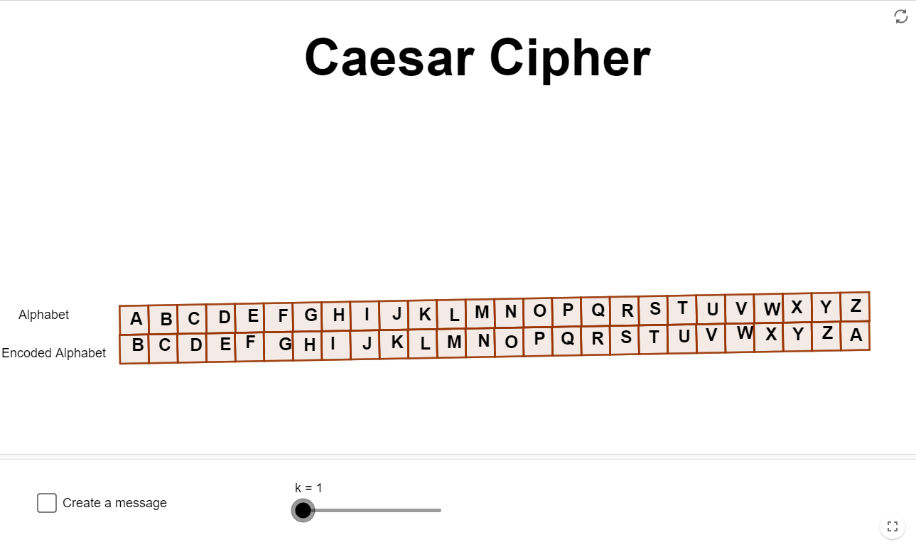
Caesar Cipher

Slide 18
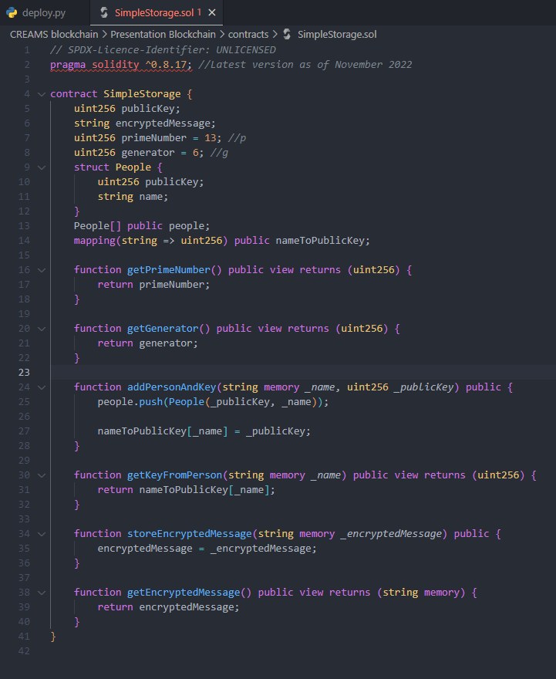
Solidity contract

Slide 19
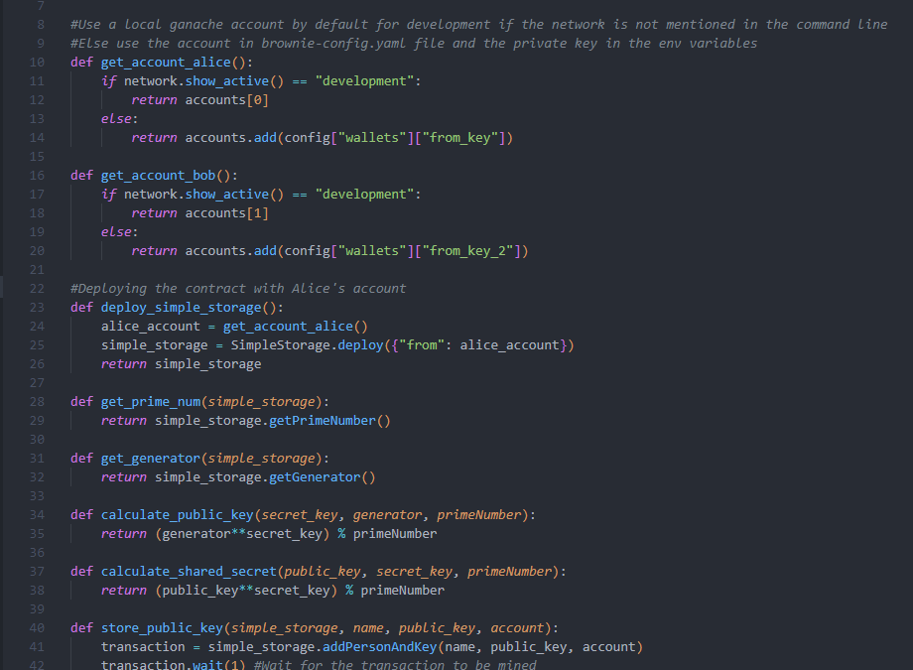

Deployment with Python (Web3.py)

Slide 20
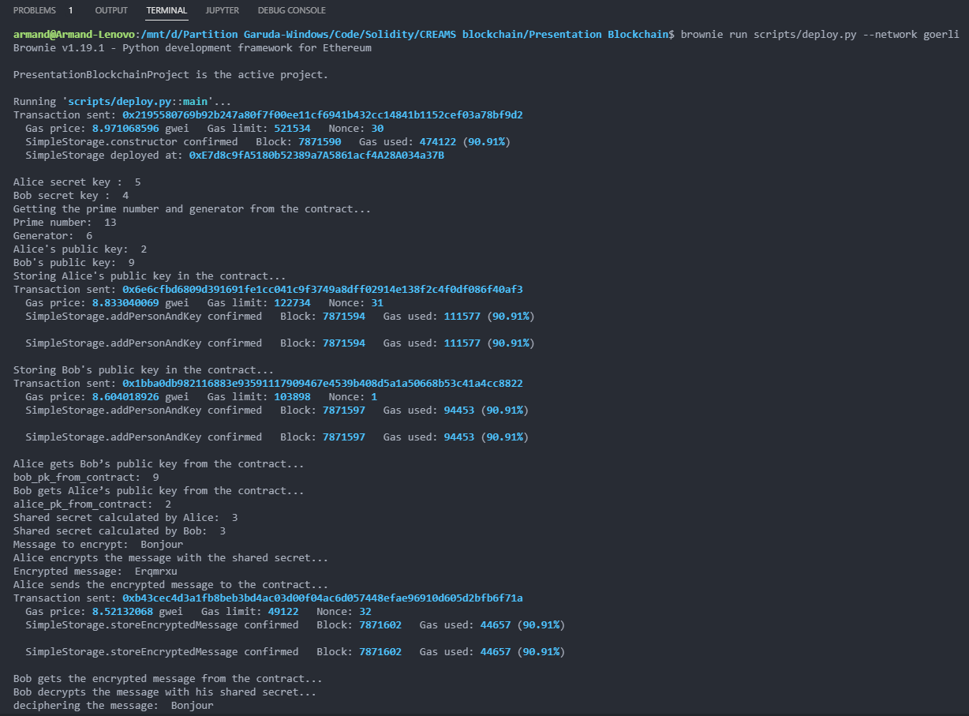
Executing the script
Address of the transaction :
https://goerli.etherscan.io/address/0xE7d8c9fA5180b52389a7A5861acf4A28A034a37B

Slide 21
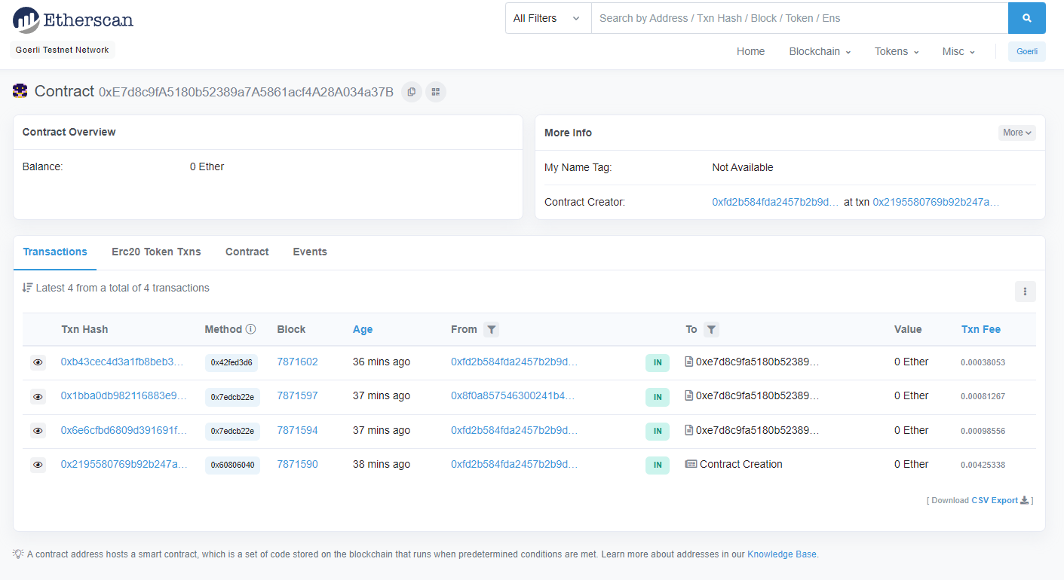
Viewing the transaction

Slide 22
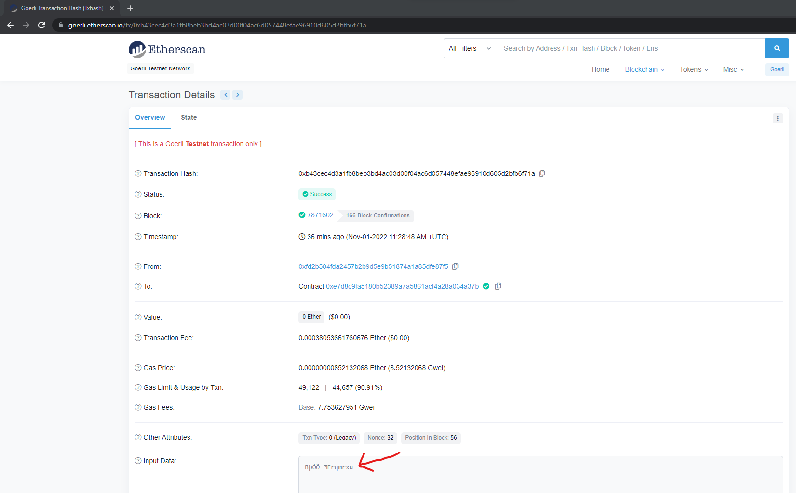
Viewing the transaction

Slide 23
Other possible uses for cryptography
Elliptic curve crytphography : Technique for generating keys and encrypting data
Digital Right Management : Encrypted media in the blockchain + distribution of the keys to legitimate users
Homomorphic encryption : Processing encrypted data without decrypting it
Multi-Party Computation : Allows multiple parties to make calculations using their combined data, without revealing their individual input.
Threshold Signature Scheme : Enables multiple users to sign a single transaction on behalf of the group
Asynchronous group key agreement : Offline devices will be able to compute the group key once they are online.
Etc…

Slide 24
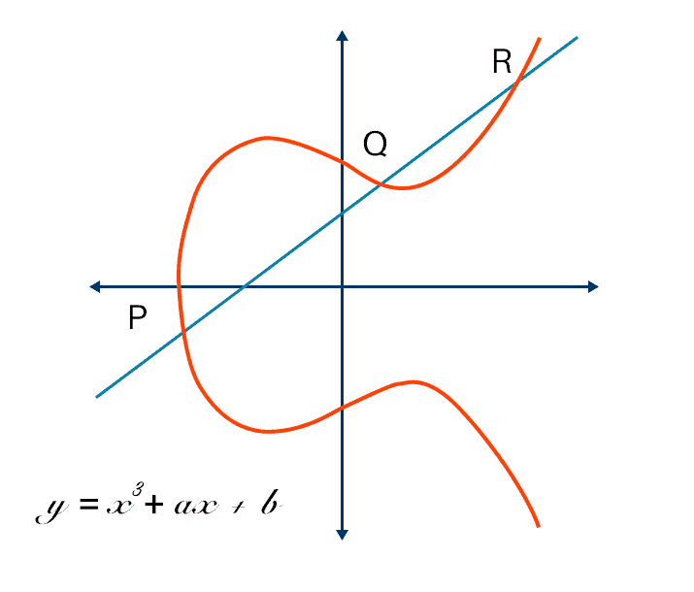
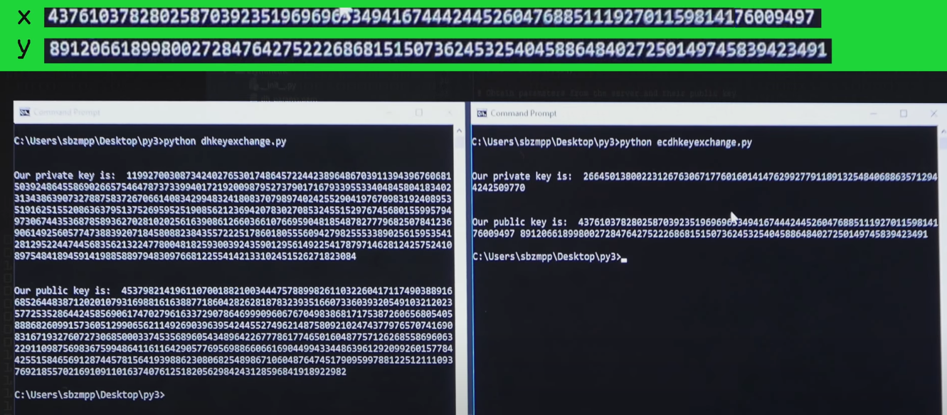
Elliptic curve cryptography
256 bit ECC key is equivalent to RSA 3072 bit keys ECC requires much shorter key lengths (fewer bits)
Requires smaller chip size, less power consumption, increase in speed, etc…
Curve used in Ethereum : secp256k1 and alt_bn128
Generator : Random point on the curve
Private key : number of mouvement around the elliptic curve
Public key : coordinated of the resulting point

Slide 25

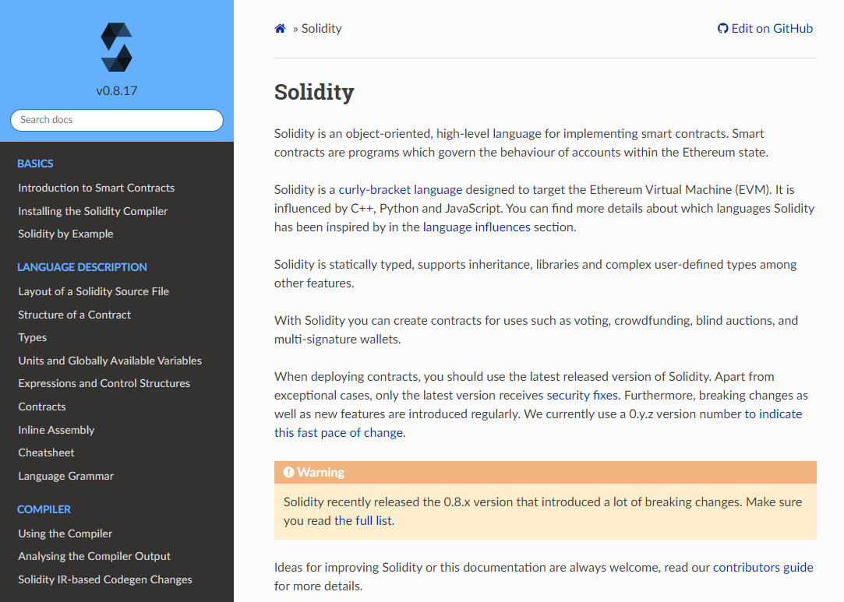

Where to learn ?

Slide 26
Tools
Solidity (Ethereum, Polygon…), Rust (Solana…)
Python / Javascript : Web3.py / Web3.js
IDE : Remix (web browser) / Visual Studio Code + Plugins
Ganache (local testnet)
Brownie (Solidity framework)
Testnet (exemple : Goerli network)
Etc…

Slide 27
Thank you for your attention

